Slide 1
Android Application Development
Lecture 1
Presented by: Hassan Khamis
Software Engineer At Trianglz

Slide 2
Outlines
Introduction
Main Components
Activities
Services
Broadcast receivers
Content Provider
Activity Life Cycle
Layouts
Linear Layout
Constraint Layout

Slide 3

Introduction

Slide 4
Main Components
Activities
An activity represents a single screen with a user interface , in-short activity performs actions on the screen.

Slide 5
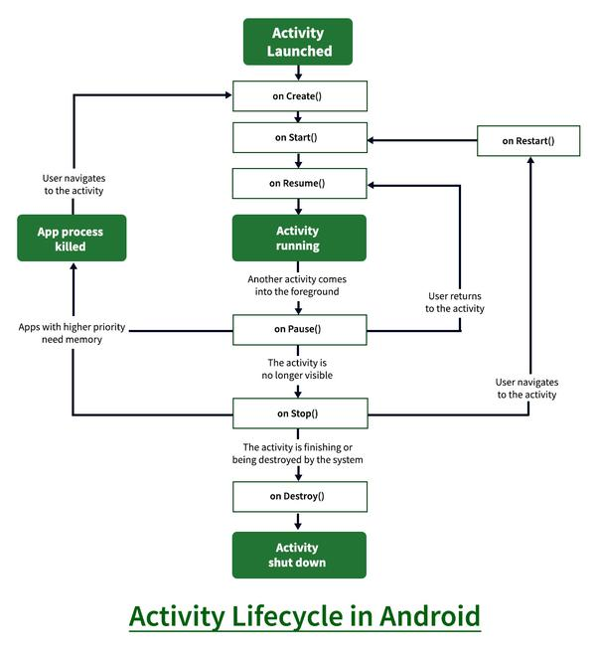
Activity Life Cycle

Slide 6
Activity Life Cycle
Cases
When Close App
When Click Back Button
When Click Home Button
When Dialog Appear
When Rotate Device

Slide 7
Main Components
Services
A service is a component that runs in the background to perform long-running operations. for example, a service might play music in the background while the user is in a different application, or it might fetch data over the network without blocking user interaction with an activity.
Types:
Foreground
Background
Intent
Bound

Slide 8


Main Components
Broadcast receivers

Slide 9
Main Components
Content provider
A content provider component supplies data from one application to others on request. Such requests are handled by the methods of the content resolver class. The data may be stored in the file system, the database or somewhere else entirely.

Slide 10
Main Components
Content provider
A content provider component supplies data from one application to others on request. Such requests are handled by the methods of the content resolver class. The data may be stored in the file system, the database or somewhere else entirely.

Slide 11
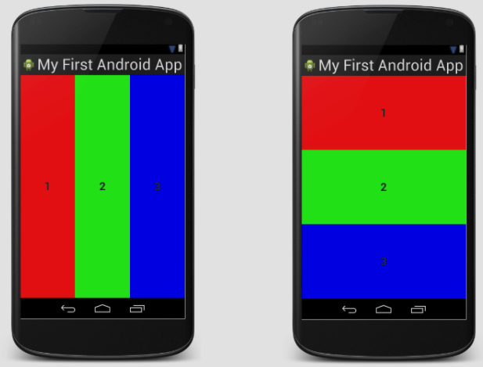
Layouts
Linear layout

Slide 12
Layouts
Constraints
Percentage
Match constraints
Baseline
Barrier
Guidelines
Chains
Bias

Slide 13
Assignment
Create Android project with 2 Activities.
First Activity contains:
Two TextView {Mobile Number, Message}
Two EditText {Mobile Number Value, Message Value}
Two Buttons {Next, Close}
Second Activity contains:
Two TextView to extract and show {Mobile Number Value, Message Value} from the intent.
One Button {close}

Slide 14
Thank you

